Slide 1
Bolivian Geography

Slide 2
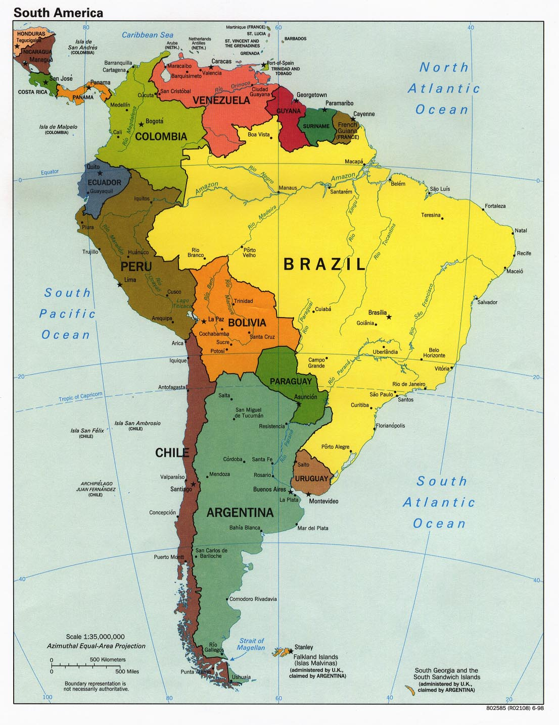
South America
Brazil is the largest of the South American countries.
2 countries are landlocked: Paraguay and Boliva.

Slide 3
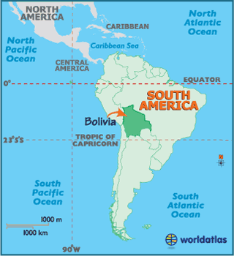
Where is Bolivia?
Central South America

Slide 4
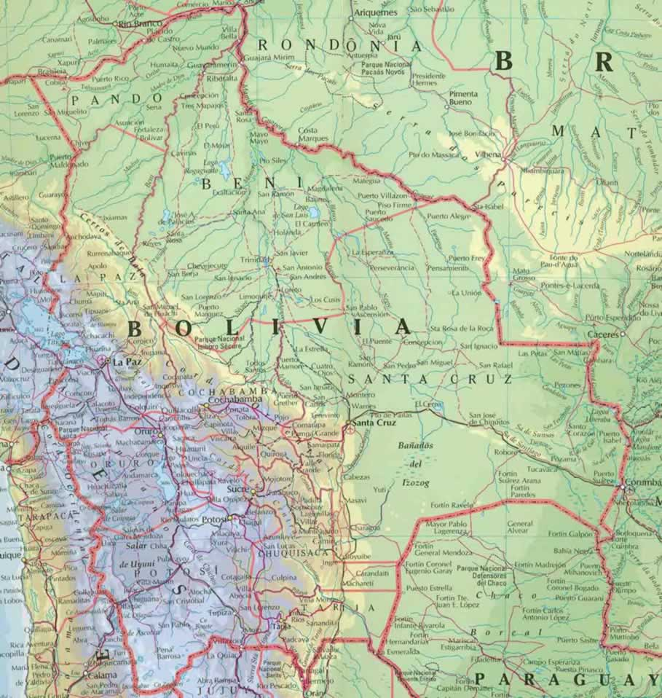
Geographical Map

Slide 5
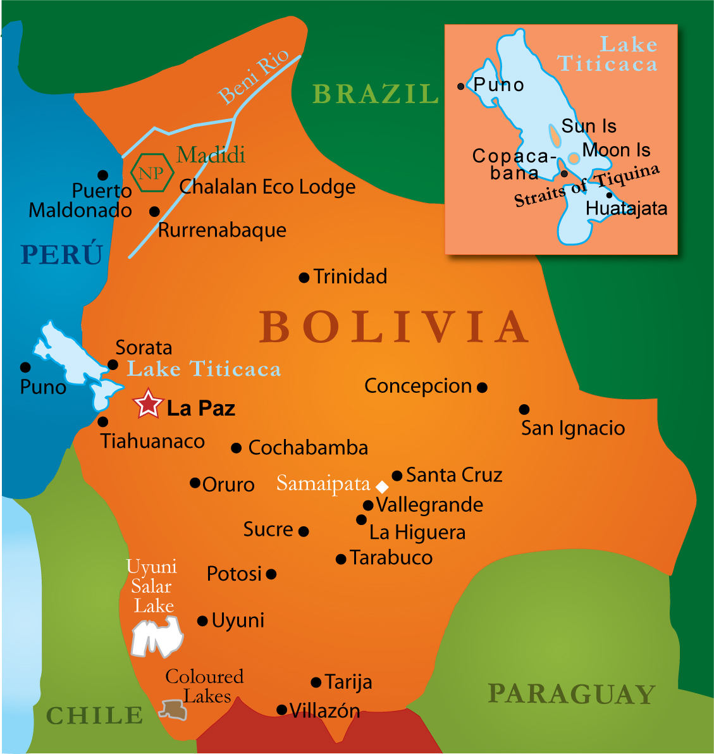
Road/City Map

Slide 6
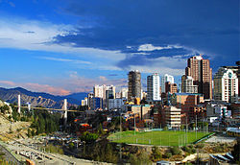
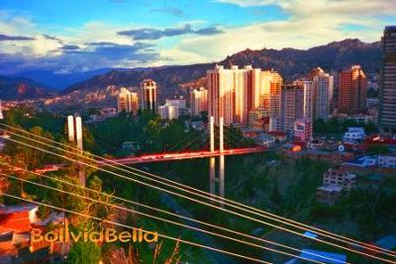
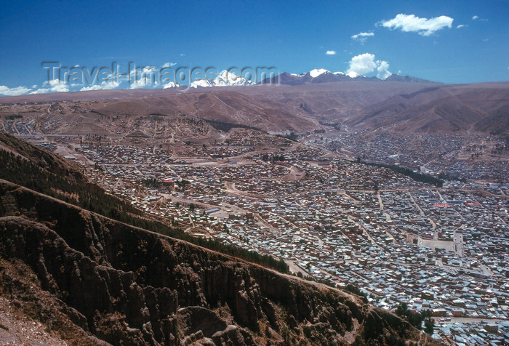
Capital – La Paz

Slide 7
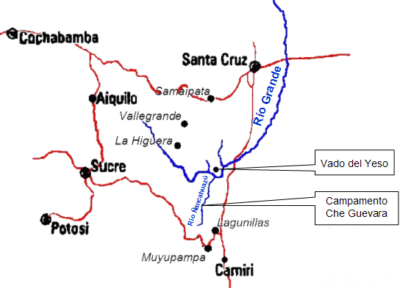
Ñancahuazú Valley – Central Bolivia

Slide 8
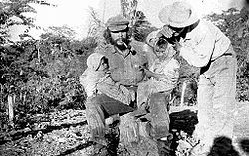
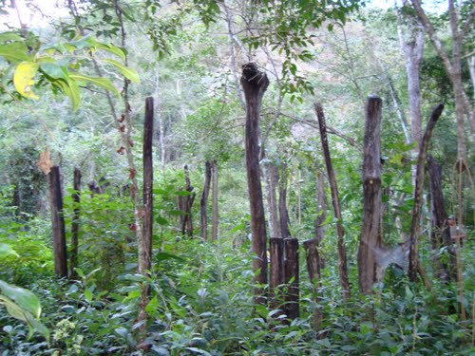
Che in the Ñancahuazú Valley
The rainforest surrounding the Base Camp of Che and his men.
Che

Slide 9
Quiz
There are 2 landlocked countries in South America. One is Paraguay what is the other one?
Where is Bolivia?
What is the capital of Bolivia?
Where in Bolivia is the Ñancahuazú Valley?
What type of environment surrounded the basecamp of Che and his men?

