Slide 1
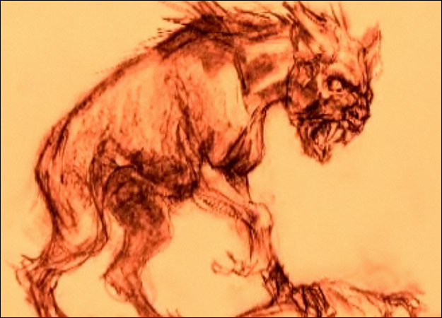
Chupacabra or Chupacabras

Slide 2
Chupacabra – Name Origin
Chupar – “to suck”
Cabra – “goat”
Chupacabra – “goat sucker”

Slide 3
Chupacabra
Legendary cryptid rumored to inhabit parts of the Americas.
A creature or plant whose existence has been suggested but is unrecognized by scientific consensus.
Sightings in Puerto Rico, Mexico, and the U. S. (especially Latin American communities).
Attacks and drinks the blood of livestock, specifically goats.

Slide 4
The First Attack
Initial claims were in 1975 in Moca and the killings were attributed too El Vampiro de Moca.
March 1995 in Puerto Rico
8 sheep, 3 puncture wounds in the chest area and drained of blood.
In August, an eyewitness Madelyne Tolentino claimed to see the creature in Canóvanas where 150 farm animals and pets were killed.
Thought to be a satanic cult.
The name Chupacabras is attributed to Puerto Rican comedian Silverio Pérez.

Slide 5
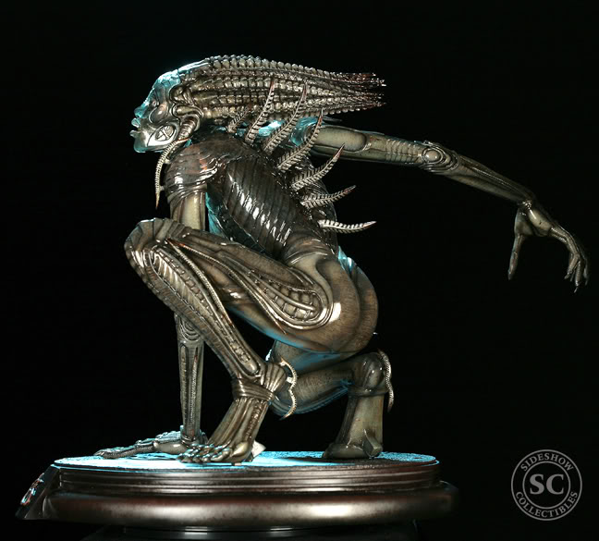
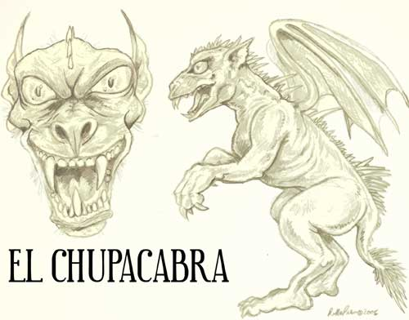
Solving the Mystery
Benjamin Radford discovered that the first description was based on the creature “Sil” from the horror flick Species.
This similarity along with the reports of blood-sucking never being confirmed by necropsy really take away the credibility of the chupacabra as an actual creature.
Necropsy – an autopsy for non-human bodies, a highly specialized surgical procedure that consists of a thorough examination of a corpse to determine the cause and manner of death.

Slide 6
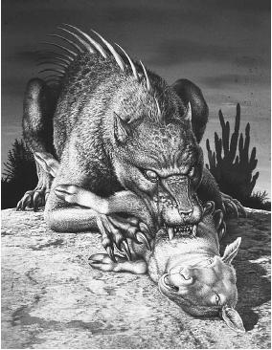
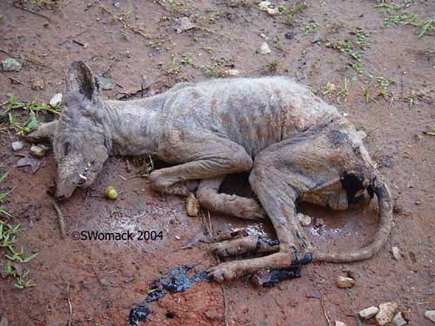
Solving the Mystery (cont’d)
Radford divided the chupacabra reports into 2 categories:
Puerto Rico & Latin America – animals were attacked and it is supposed their blood was extracted.
U.S. – mostly dogs & coyotes with mange the were called “chupacabra due to their appearance.

Slide 7
Reported Sightings
July 2004, San Antonio Texas
Killed a dog-like creature
October 2004
2 more carcasses found in surrounding area.
April 2006, Cntral Russia
32 turkeys, later 30 sheep
August 2006, Turner, Maine
“Evil looking” rodent-like animal
May 2007, Colombia
300 dead sheep
August 2007, Cuero, Texas
3 strange carcasses
And MANY more!!

Slide 8
Appearance – Most Common
Leathery or scaly greenish-gray skin
Sharp spines or quills on its back
3-4 feet tall
Stands and hops like a kangaroo
Dog or panther-like nose and face
Forked tongue
Large fangs
Hiss and screech when alarmed
Sulfuric stench

Slide 9
Appearance – Less Common
Strange breed of wild dog
Mostly hairless
Pronounced spinal ridge
Pronounced eye sockets
Fangs
Claws

Slide 10
Related Legends
Philippines → Sigbin
Southeast Asia → cat-fox
Chile → Peuchen
New Orleans → Grunches

